Slide 1
PRMO
Session 1

Slide 2
Objectives
Research and review the basics of the human brain.
Describe the basic structures of the brain.

Slide 3
Understanding the Brain Describe the basic structures of the Brain
Proceeding upward from the spinal cord, starting at the point where the CNS enlarges into the brain, neuroanatomists have classified brain tissue into three major sections:
the hindbrain,
the midbrain,
and the forebrain. (Levinthal & Hamilton P 68)

Slide 4
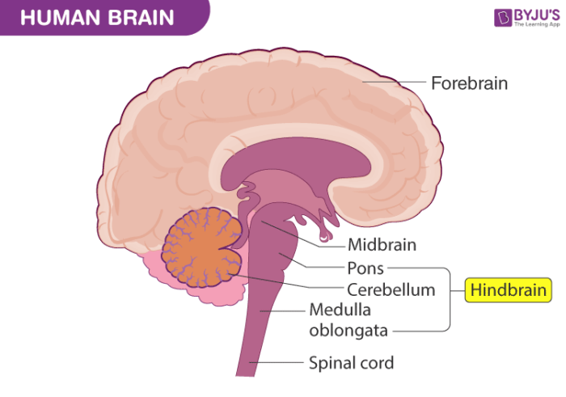
The older and more primitive systems of the brain tend to be underneath the newer and more sophisticated ones, so as we travel upward from hindbrain to midbrain to forebrain on our quick tour, we are dealing with structures that have evolved ever more recently and have greater involvement in complex behaviour.

Slide 5
Figure 3.5 P 68

Slide 6
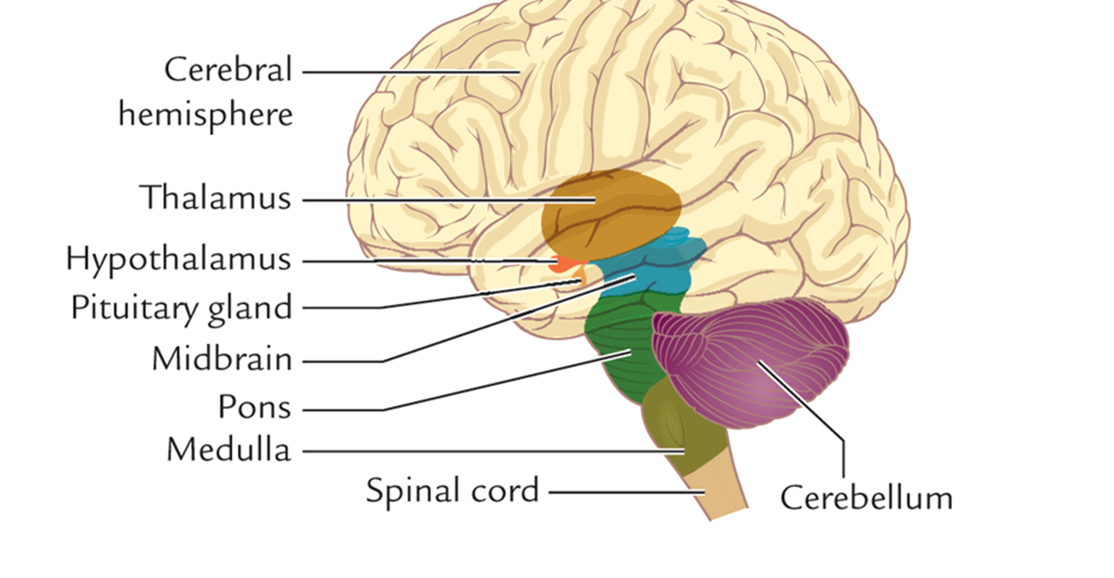
The HindBrain
At the top of the spinal cord, neural tissue suddenly widens and enlarges into the hindbrain. The medulla lies at the point of the hindbrain where this enlargement has just begun (Figure 3.5). It is essentially the coordinator of the basic life-support systems in our body. Blood pressure is controlled here, as are the rhythms of breathing, heart rate, digestion, and even vomiting. Death would be seconds away were it not for the normal functioning of the medulla. Unfortunately, it is highly sensitive to opioids (Chapter 5), alcohol (Chapter 8), barbiturates, and other depressants (Chapter 13). When levels of any of these drugs are excessive in overdose cases, the respiratory controls in the medulla are inhibited, and death can result from asphyxiation (lack of breathing). P 68

Slide 7
The Pons
Another hindbrain structure, situated just above the medulla, is the pons. We can view the pons in terms of our ability to maintain the necessary level of alertness to survive. Within the pons are structures that determine when we sleep and when we wake up, as well as the main portion of a structure called the reticular formation that energizes the rest of the brain to be alert to incoming information. Drugs affecting the patterns of our sleep influence centres in the pons and reticular formation. P 68

Slide 8
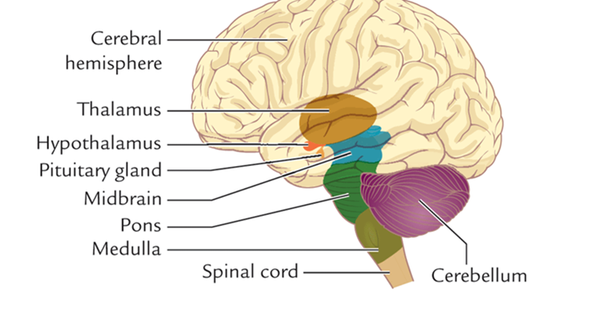
Cerebellum
Behind the medulla and the pons in the hindbrain is the cerebellum, an important structure for the maintenance of balance and for the execution of smooth movements of the body. The dizziness and lack of coordination we experience after consuming alcohol are attributable in large part to alcohol’s depressive effect on the cerebellum. P 68

Slide 9
The Midbrain
The midbrain, located just above the hindbrain, is a centre for the control of important sensory and motor reflexes, as well as for the processing of pain information. Without a specific region of the midbrain called the substantia nigra, we would not be able to control the movements of our bodies effectively. The muscular tremors and other motor difficulties characteristic of Parkinson’s disease are a result of degeneration of the substantia nigra. Unfortunately, symptoms that resemble Parkinson’s disease have been frequently observed in patients taking antipsychotic medications for the treatment of schizophrenia. P 69

Slide 10
The Forebrain
Finally, in the uppermost section of the brain are the most recently evolved systems in the brain, collectively referred to as the forebrain. One of these forebrain systems, lying immediately above the midbrain, includes the hypothalamus and the limbic system. It is through these structures that we are able to carry out the motivational and emotional acts that ensure our survival as a species. Feeding behaviour, drinking behaviour, and sexual behaviour are controlled by the hypothalamus. P 69

Slide 11
The Limbic System
The limbic system surrounds the hypothalamus and plays a central role in organizing emotional behaviour during times of stress. Experimental lesions in points within the limbic system can turn a tame animal into a raging monster or a wild animal into a docile one. Not surprisingly, theories about the basis for psychological dependence have focused on the limbic system…Drugs that deal with symptoms of anxiety, depression, and schizophrenia affect regions within the limbic system. P 69

Slide 12
https://ca.images.search.yahoo.com/search/images

Slide 13
Limbic system damage Damage to different parts of the limbic system has different effects. For example:
Hippocampus: Damage to this part of the brain disrupts memory and learning, and it can contribute to dementia symptoms. In Parkinson’s disease, damage here can worsen thinking skills.
Cingulate gyrus: Harm results in inappropriate emotions, such as a lack of fear. It also causes impairments in learning and pain perception.
Amygdala: Harm to the amygdala can also affect a person’s fear conditioning, as well as their ability to regulate their emotions.
Hypothalamus: Damage here causes atypical functioning that links to several mental health conditions. Underactivity may worsen depression, and hyperactivity may cause excessive anxiety.
Basal ganglia: Harm may result in tremors, atypical postures, and involuntary movements. It also links to movement conditions, such as Parkinson’s disease.
Retrieved from https://www.medicalnewstoday.com/articles/limbic-system#damage

Slide 14
Cerebral Cortex
The second forebrain system, and the most important from the standpoint of understanding human behaviour, is a two-sided, wrinkled sheet of neural tissue with a thickness approximately equivalent to the height of a capital letter on this page. Overhanging nearly all of the brain, the hemispheres of the cerebral cortex resemble a giant walnut, … P 69

Slide 15
3.6 Understanding the Neurochemistry of Psychoactive Drugs
3.6 a Discuss the structure and the functioning of neurons
3.6b Discuss the stages of synaptic transmission
3.6c Compare and contrast ionotropic and metabotropic receptors P 70

Slide 16
Introducing Neurons
There are an estimated 86 billion neurons in the adult brain, and an estimated 10 to 100 trillion structures (called synapses) where these neurons communicate with each other.
Not surprisingly, the brain is the most complex organ of the body.

Slide 17
Action Potential
The neuron itself, as the basic unit of the nervous system, can be understood in relatively simple terms. Imagine the neuron at any moment in time as a tiny device that can turn on or off, like a light switch. In terms of the neuron, the “on” state is accomplished by the generation of an action potential, sometimes referred to as a nerve impulse.
Just as the neuron is the basic unit that forms the structure of the nervous system, the action potential is the basic event that forms the language of the nervous system. P 71

Slide 18
action potential
An electrical message generated at the cell body that moves down the axon and causes release of neurotransmitters.

Slide 19
The unique role of the neuron is to receive information and to transmit information, a task that it carries out through its three principal components: the cell body, the dendrites, and the axon (Figure 3.7).

Slide 21
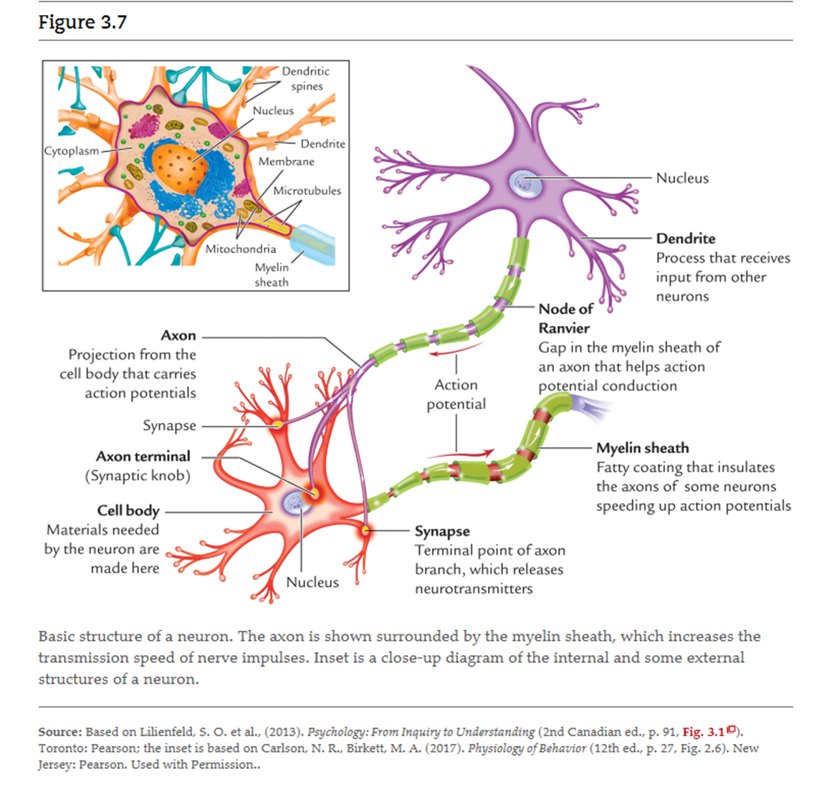
The long appendage, called the axon, is the part that transmits the action potential from the cell body to the end of the axon, called presynaptic terminals.

Slide 22
Action Potential
The neuron is the basic signalling device in the nervous system that uses individual signals called action potentials. The outside of a neuron, called the extracellular space, is covered with a distribution of positively charged and negatively charged ions that is different from the distribution of positive versus negatively charged ions inside the neuron. P 71

Slide 23
Many more sodium (Na+) and chloride (Cl−) ions are concentrated on the outside of a neuron, whereas more potassium (K+) ions are concentrated on the inside of the neuron. This sets up a potential difference in electricity between the inside and outside of a neuron when the neuron is at rest. This is called the resting membrane potential and can range from about –40 to –90 mV depending on the type of neuron. When the neuron becomes active (more about this later) there are specific ion channels that open up and allow particular ions in or out. P 71

Slide 25
When an action potential is generated, it travels down the length of the axon at speeds up to 120 metres per second (432 km/h) until it reaches the axon’s terminals.
If we followed the nerve impulse down the length of the axon, starting from the cell body (sometimes a distance of as long as a metre), we would see that, toward its end, the axon diverges like the branches of a tree. These branches are called axon collaterals.
At the terminal point of each of these branches are the small button-like presynaptic terminals. If nothing else happened here, the action potential would sputter out like a wet fuse. But, of course, there is more to the story. By virtue of junctures between neurons called synapses, action potentials from one neuron can influence the generation of action potentials in other neurons.
This process is referred to as synaptic transmission, where the electrical signal—the action potential—becomes a chemical signal that is carried by neurotransmitters. P 72

Slide 26
Synaptic Transmission
The neuronal changes that result from most psychoactive drugs occur because they alter at least one of the basic stages of synaptic transmission

Slide 27
Ionotropic and Metabotropic Receptors
When a neurotransmitter binds to a receptor, the properties of the receptor itself will determine what happens in the dendrite of the postsynaptic neuron.
There could be a fast excitation or inhibition, or a longer-lasting intracellular event.
Two general types of receptors can be present on the postsynaptic terminal (Figure 3.11).

Slide 29
ionotropic receptor A cell membrane receptor-ion channel complex that allows specific ions to pass through when the receptor is activated.
metabotropic receptor A cell membrane receptor that is linked to a G protein. Activation results in the production of a second messenger that can have a variety of intracellular functions. P 75

Slide 30
Reference
(Levinthal, 20210521)Levinthal, C. F., Hamilton, T. (20210521). Drugs, Behaviour, and Modern Society (Canadian Edition), 2nd Edition. [[VitalSource Bookshelf version]]. Retrieved from vbk://9780136690269

