Slide 1
PRVO
Course & Assignment Overview

Slide 2
PRVO Course Overview
Log into MyCampus
See your current course listing on the left-hand side.
Select PRVO – Preventative Health Promotion
You should be at the PRVO course homepage now.

Slide 3
Course Outline

Slide 4
View the required textbooks in the course outline

Slide 5
Textbooks
Will appear on the right-hand side of the PRMO course homepage, under Textbook resources.
You have to be logged in, read through the course outline, and do a few activities in session. (30 mins) then log out and log back in to refresh MyCampus.
I suggest using the textbook resources link rather than the session reading links.

Slide 6
Vital Source

Slide 7
Course duration
20 hours per week for 2 weeks (40 total course hours)

Slide 8
Course Objectives

Slide 9
Course Objectives

Slide 10
Attendance
Students are required to log in regularly and complete each week’s course
material. There are activities and assignments due each session. Student
progress is tracked by the completion of these activities, and failure to complete
them will result in a marked absence.

Slide 11
Course Assessment

Slide 12
Course Assessment

Slide 13
Attendance and Progress Tracking
Online students are required to sign in to the MyCampus LMS for at least 30 minutes on the first day of the course. This activates your access to the course content and confirms your presence. Students are expected to complete activities and/or assignments each session. Progress is tracked by the completion of these activities and a failure to complete them will result in a marked absence.
For virtual classes, we recommend students attend the live sessions with the instructor. If students cannot attend these live sessions, they should access the recordings uploaded into the Virtual Classroom. Some sessions have mandatory live attendance, which will be indicated by Student Services and/or the instructor.
Contact Student Services via e-mail (in the Virtual Classroom) in the following circumstances:
If you are unable to complete the required hours per week.
If you expect a delay in your academic progress.
If you expect to be absent from the required amount of attendance.
Supporting documents (doctor’s note, travel documents, etc.) may be required. Check your my CDI e-mail accounts for any attendance and/or academic progress messages.
Students are expected to allocate additional time to their coursework where necessary, in order to meet the learning objectives and assignment requirements of this course.

Slide 14
Lockdown Browser

Slide 15
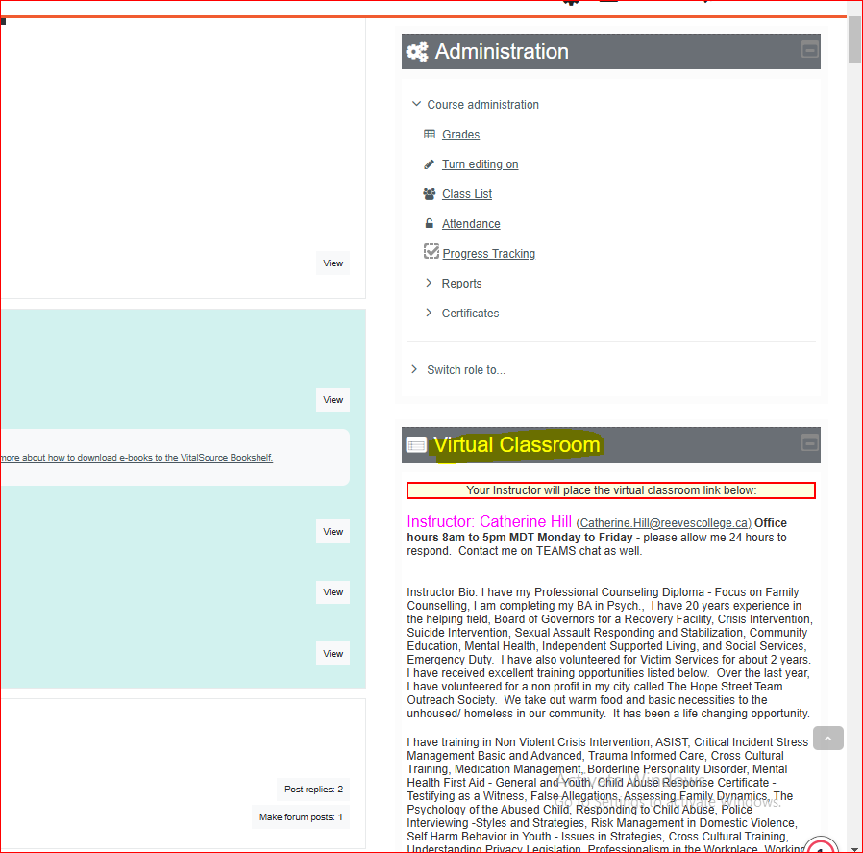
Virtual Classroom Block
See the virtual Classroom Block on the course homepage this is where your live session recordings will be (you will also find them in your teams main chat channel). You will also see your hard copy of the test reviews in the VCB (virtual classroom block).

Slide 16
Sessions

Slide 17
Assignments see session 1 for instructions

Slide 18
Assignment # 1

Slide 20
Assignment 1 Instructions continued

Slide 21
Assignment # 1 Continued

Slide 22
submission instructions
CatherineHillPRVOWellnessWheel

Slide 23
Assignment # 1 Grading Criteria

Slide 24
Assignment # 1 Rubric

Slide 25
Example of a wellness wheel

Slide 26
Assignment # 1 Submission in Session 5

Slide 27
Add Submission

Slide 28
Click on the paper icon highlighted below

Slide 29
Choose file - select from the location it’s saved on your device.

Slide 30
Save changes

Slide 31
Assignment # 2

Slide 32
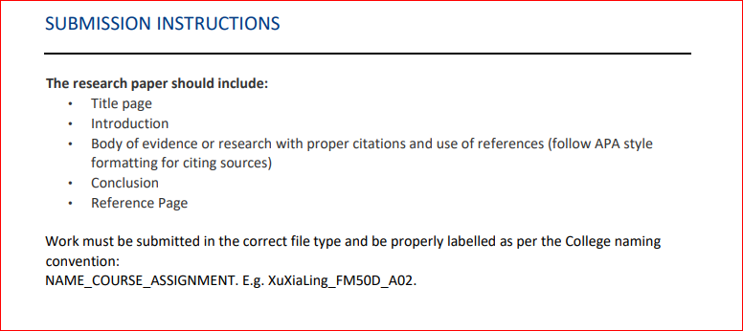
Submission of Assignment # 2
same as assignment # 1

Slide 33
Research Assignment Instructions
You can create it in a word document or PowerPoint Slide Show.
Follow APA style formatting – even if it’s in PowerPoint.
Title page
Reference Page
https://apastyle.apa.org/style-grammar-guidelines/paper-format

Slide 34
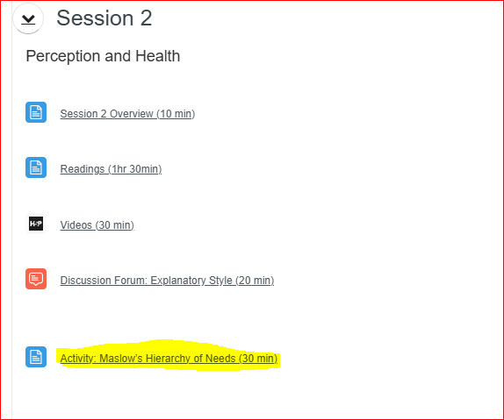
Activities
0/0 = F - this will count in your participation mark at the end of the course. the 0/0 just means the activity itself has no weight on the final mark except in participation percent.

Slide 35
Exams
You will see the link for the exams a couple of days before it’s due
Final exam Session 10.
If you can’t write it on the Friday then you have until Sunday to take the exam.
Once you start you have to finish the attempt.
You need 70 % to pass the exam
If you do not pass – you will get one more attempt but will have to wait 24 hours to make another attempt.

