Slide 1
PRVO
Session 2 Perception and Health Chapters 5 & 6

Slide 2
Explanatory Style and Health
What Is Explanatory Style?
Explanatory style is the way in which people perceive or explain the events in their lives.
Explanatory style can be either optimistic or pessimistic,
Explanatory style consists of three dimensions:
(1) whether you believe you have control or influence over the things that happen in your life (the internal/external dimension);
(2) whether you believe a repeated event will always turn out the same or can be changed (the stable/unstable dimension); and
(3) whether you recognize a specific event as fairly isolated or you generalize it to encompass many other events (the global/specific dimension). P 104

Slide 3
Characteristics of Optimists
…optimism is “the tendency to seek out, remember, and expect pleasurable experiences. It is an active priority of the person, not merely a reflex that prompts us to ‘look on the sunny side p 105

Slide 4
An Optimistic or Pessimistic Explanatory Style
Those with an optimistic style:
Are hopeful
Work hard and persist in order to overcome obstacles
Seek advancement
Inspire others
Are bold and adventurous
Explore, seize possibilities, and discount or dismiss risks
Recover quickly from setbacks
Are unlikely to suffer from depression p 107
Too much optimism can also cause people to avoid responsibility, take unwise risks, become reckless, or make unrealistic plans.

Slide 5
Those with a pessimistic style:
Have a keen sense of reality
Are skeptical and defensive
Are cautious and timid
Highlight and emphasize risks, seeking to protect themselves and others
Are conservative
Recover slowly—if at all—from setbacks, and tend to wallow in defeat
Excessive pessimism can result in unwarranted fear, anxiety, guilt, or shame. It can also cause inaction, passive behavior, and depression. P 107

Slide 6
How Permanent Is Explanatory Style?
Some research indicates it’s genetic
Other research indicates it’s a learned behavior, there is the potential for change. P 108

Slide 7
three main sources from which we learn explanatory behavior
1. The mother (or other primary caregiver). If a mother consistently blames herself or her child when bad things happen, the child will pick up on those cues and develop a pessimistic explanatory style.
2. Other adults who care for, discipline, teach, and criticize a child (including parents, teachers, and other influential adults). If these consistently blame the child, his personality, or his character when bad things happen, the child quickly learns to use personal and permanent explanations when things go wrong.
3. Tragic life crises. A child who experiences a crisis—loss of a parent, the divorce of parents, extreme poverty, abuse, or loss of the home—will notice whether the crisis gets resolved after an appropriate period of time or whether the effects appear likely to last forever. A child who sees that adversity is temporary and can be overcome is more likely to develop an optimistic explanatory style. P. 108

Slide 8
Dr Albert Ellis and the ABCDE mnemonic
One technique that uses an ABCDE mnemonic was developed by Dr. Albert Ellis to help people overcome a tendency to pessimism and has been used in cognitive therapy to help people make significant change:24
Adversity: when adversity happens—as it always will—think about what caused it.
Belief: determine how you explain the failure to yourself.
Consequences: if you have a negative belief (pessimistic explanatory style) about what caused the event, realize those negative beliefs will have consequences—you might feel shame, get depressed, or feel overwhelmed.
Dispute your negative beliefs. Create more accurate, objective beliefs to explain the adversity.
Energize yourself through your new optimistic outlook. P 108

Slide 9
The Influence of Explanatory Style on Health
An early researcher in psychoneuroimmunology, Yale surgeon Dr. Bernie Siegel maintains that a negative explanatory style is harmful to the body. Pessimism itself has been shown to be a stressor. On the other hand, he says, an optimistic explanatory style and the positive emotions it embraces—such as love, acceptance, and forgiveness—stimulates the immune system and kicks the body’s own healing systems into gear. An optimistic explanatory style sends “live” messages to your body and helps promote the healing process
Overall, optimists have less illness and recover more quickly than pessimists. P 109

Slide 10
Although it’s essential to have an optimistic explanatory style, says Siegel, it’s also crucial to use that explanatory style to deal with the realities in life:
Learning to let go of negative emotions is the key.
The person who smiles on the outside and is hurting on the inside is not dealing with himself or his life. All his “live” mechanisms are told to stop working. Doctors see examples of this every day. You are making rounds at the hospital and you ask a patient how she’s doing and she says “Fine.” But you know she’s not doing fine. Her husband ran off with another woman. Her son is on drugs. And she has cancer. But still she says, “Fine.” When I find a person who answers, “Lousy,” I say, “That’s wonderful! You want to get better so you’re dealing with the truth. If your mind and body are feeling lousy and you’re relating to that, you’ll ask for help.”36

Slide 11
Impact on Mental Health
According to research, explanatory style can have a tremendous impact on mental health.
Evidence suggests that optimistic people have a significantly better sense of mental well-being and are much less vulnerable to mental disorders, especially mood and anxiety disorders. Much of that effect is likely due to the fact that optimism increases coping abilities, improves cognitive responses, increases problem-solving capacity, and enhances the ability to handle stress. P 111

Slide 12
Impact on Physical Health
… the ability of optimists to better manage stress, moderate the consequences of stress, and demonstrate better coping strategies in general, all of which can protect the immune system. P 112

Slide 13
Chapter 6 Locus of Control, Self-Esteem, and Health
What Does Locus of Control Mean?
Locus of control involves the extent to which we believe that our own actions will be effective enough to control or master the environment.2
People who believe they are generally in control of their destiny have what’s called an internal locus of control.
Those who believe that either other people or luck determine their destiny have the opposite—what’s called an external locus of control.
Control” in this context does not refer to our control of other people, the environment, or our circumstances, whether good or bad…It’s a deep-seated belief that we can impact a situation by how we look at the problem. We can choose how we react and how we respond. P 119

Slide 14
A health locus of control
is the degree to which we believe our health is controlled by internal or external factors.
The most healthful attitude, of course, is one in which we believe that our health is directly the result of our behavior—because then we are free to change factors within our control to influence the outcome of our health p 120

Slide 15
Those with an internal locus of control:
Are more likely to work for achievements
Will tolerate a delay in reward
Generally plan for long-term goals
Lower expectations of success and re-evaluate future performances after failing at a task
Are better able to resist coercion
Can more easily tolerate ambiguity
Are less prone to depression, helplessness, and anxiety
Realize greater benefits from social supports
Prefer games based on skill
Are more prone to guilt
Are more willing to take risks
Are more likely to embark on self-improvement programs
Recover mental health more rapidly when adjusting to a physical disability p 120

Slide 16
Those with an external locus of control:
Are more likely to lower their goals if an achievement appears too daunting
Raise their expectations after failing at a task
Are less likely to tolerate delayed gratification
Are more prone to plan for short-term goals but avoid planning for long-term goals
Are more prone to learned helplessness and depression
Are less willing to take risks
Are less likely to work on self-improvement programs or tasks
Prefer games based on chance or luck p 120

Slide 17
What Is the Source of Control?
people whose efforts are pretty consistently rewarded develop an internal locus of control.
Those who tend to fairly consistently fail, regardless of the effort they expend, tend to develop an external locus of control.
In other words, internals see a causal relationship between behavior and rewards; externals don’t p 122

Slide 18
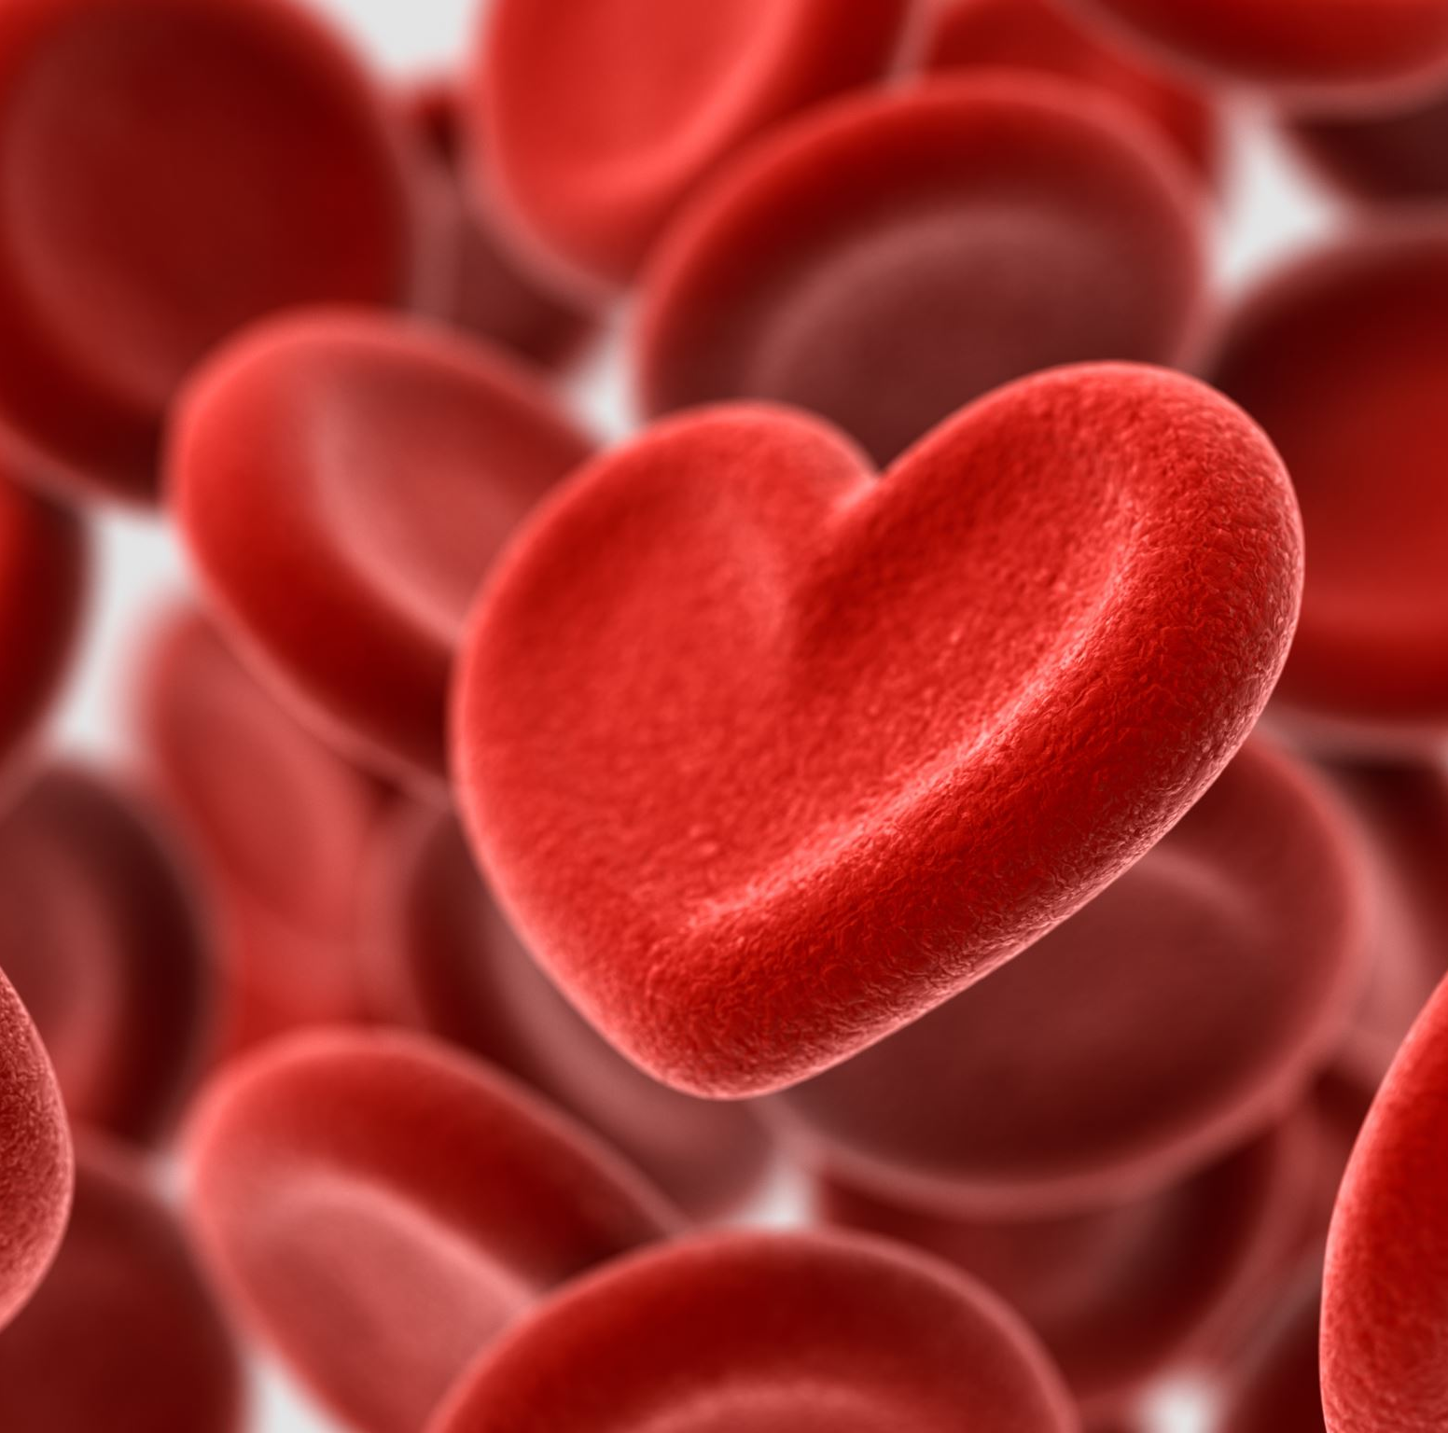
Self-Esteem
According to a growing body of evidence, a healthy self-esteem is one of the best things we can do for overall health, both mental and physical.
a good, strong sense of self can apparently help boost the immune system, improve heart function, protect against disease, and aid in healing. P 128

Slide 19
What Is Self-Esteem?
Self-esteem is the core belief we have about ourselves—a sense of positive self-regard, or the degree to which we like or dislike ourselves.53
It’s a way of viewing ourselves as good people.
It’s a sense of feeling good about our capabilities, physical limitations, goals, place in the world, and relationship to others.
Self-esteem is a powerful element: our perceptions about ourselves are what set the boundaries for what we can and cannot do.
Self-esteem can be called the blueprint for behavior.

Slide 20
A sense of high self-esteem means we appreciate ourselves and our personal worth. We have a positive attitude, see ourselves as competent, and feel in control of our lives.
The value we assign to ourselves, self-esteem, begins in childhood and is generally based on five factors—two physical and three psychological.
The physical factors that determine our self-esteem are
(1) our appearance (the way we look) and
(2) our physical abilities.
The psychological determinants of self-esteem are
(1) how well we do in school (our perceived intelligence),
(2) how confident we are in social situations, and
(3) how we regard ourselves. P 128

Slide 21
The Impact of Self-Esteem on the Body
The level of self-esteem we have appears to be a crucial factor in how we respond to stress, regardless of personality type.
Self-esteem is so powerful an influence on health that it even impacts the way we react to life events—situations in life that researchers have determined cause stress. Whether these stressors cause a person to become ill depends on many factors, including one’s ability to cope with the stress. P 130

Slide 22
Self-Efficacy: Believing in Yourself
An important part of self-esteem is what psychologists call self-efficacy, your perception of your own ability to do a specific task and to overcome the difficulties inherent in that specific task…It’s your belief in yourself, your conviction that you can manage the adverse events that come along in your life.
Belief in oneself is one of the most powerful weapons we have in protecting our health and living longer. It has a startling impact on wellness. And we are able to harness it to our advantage. P 132

Slide 23
Reference Slide
(Karren, 20141218)Karren, K. J., Smith, L., Gordon, K. J., Frandsen, K. J. (20141218). Mind/Body Health: The Effects of Attitudes, Emotions, and Relationships, 5th Edition. [[VitalSource Bookshelf version]]. Retrieved from vbk://9780133865028

